Slide 1



SECURE SMART PARKING
Presented By
Ahmed Mohamed Elkholy
201600281
Mohamed Khaled Basha
201600443
Mohamed Ahmed Shama
201600428
Ali Emad fekry
201600378
Supervisor
Dr: Sanaa Abdel Dayem

Slide 2
Introduction to Secure Smart Parking (SSP)
What is SSP
Problems
Security
Solutions
Rivest Cipher 4(RC4)
Secure Sockets Layer(SSL)
Website overview
Component & Prototype
Video for SSP operation
Encryption

Slide 3

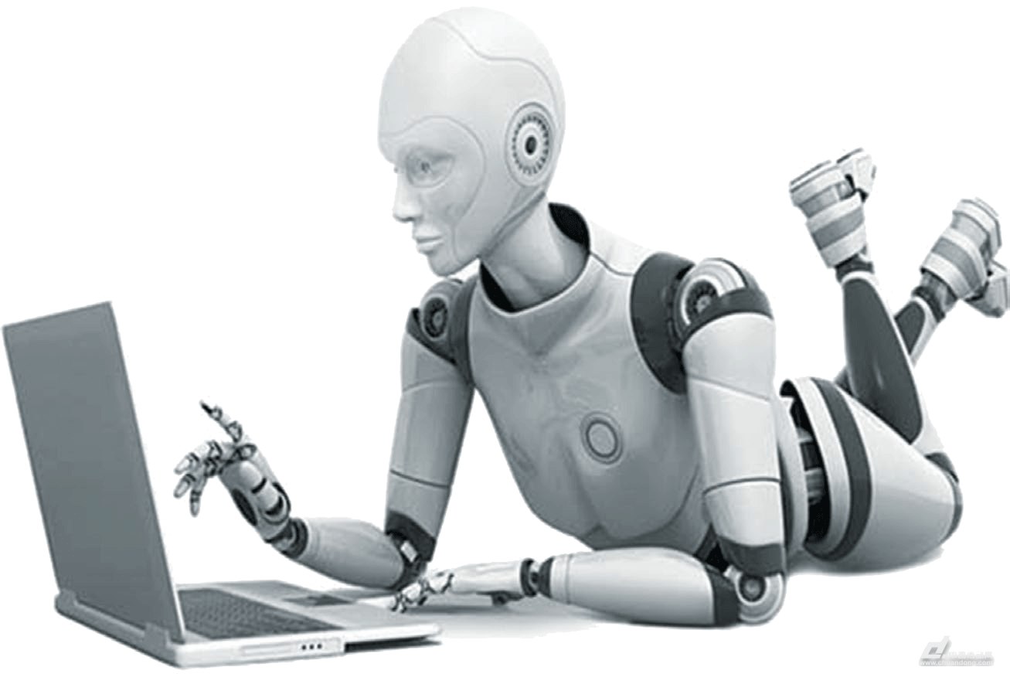

Web Application
AI
IOT Security

Slide 4



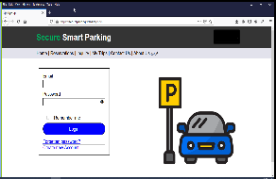

Problems
Server side
Data are processing on our server
Client side
Data are processing on PC of client

Slide 5


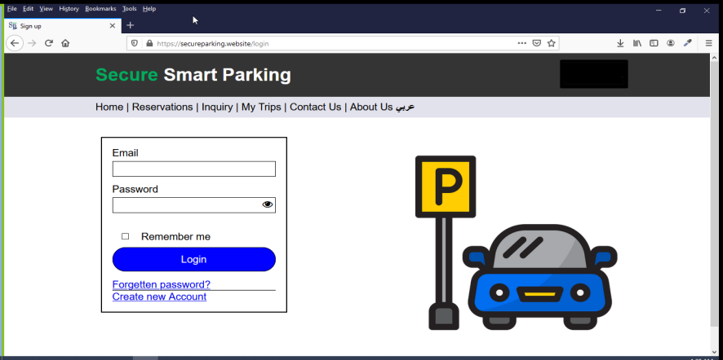

Problems
When a visitor wants to load a page on your website
Apache returns a response with all the requested files (text, images, etc.).
After write domain name the browser sends a request to server.
Through the HTTP protocol
Request
Response

Slide 6
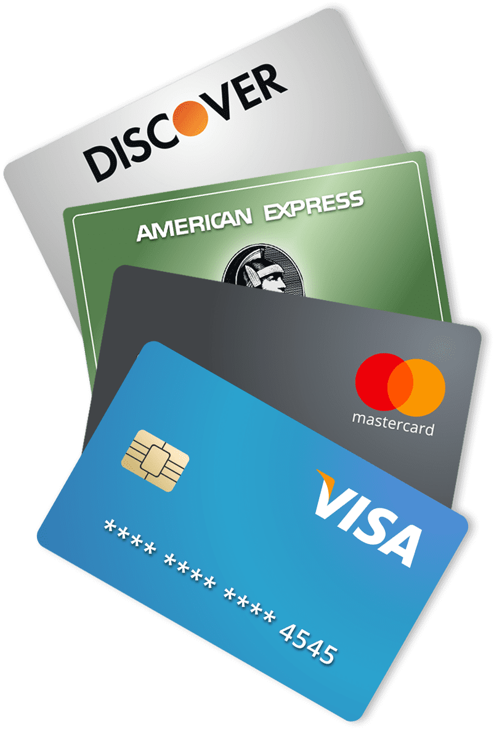

Problems: Most common sensitivity information
The most of people use the same password for all websites accounts
Electronic financial transactions

Slide 7
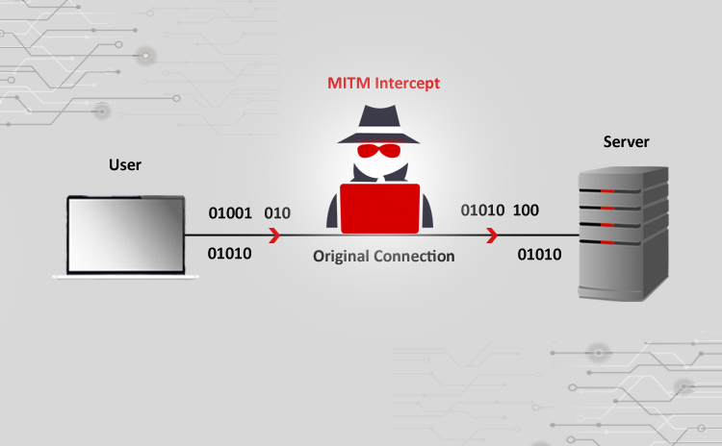
Problems: Types of attacks
Man in the middle attack

Slide 8
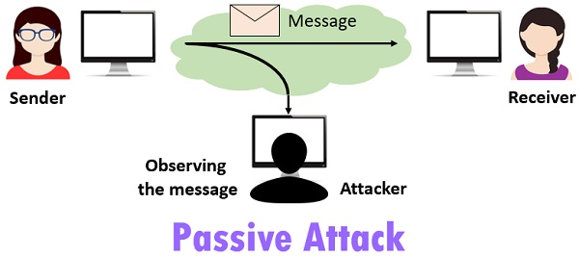
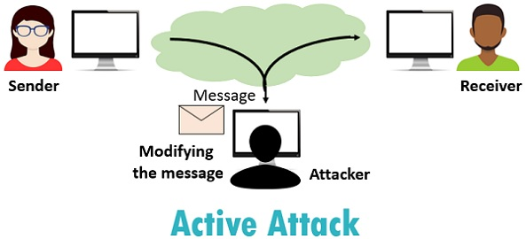
Man in the middle attack
Passive Attack
Active Attack

Slide 9
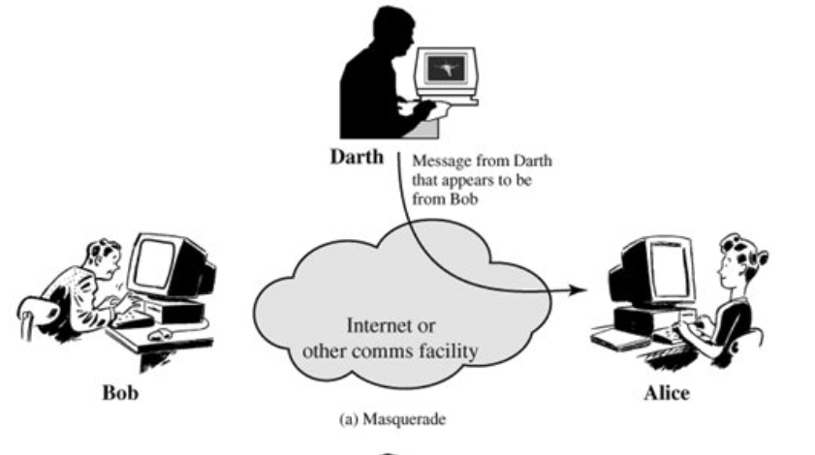
Active attack
Masquerade

Slide 10
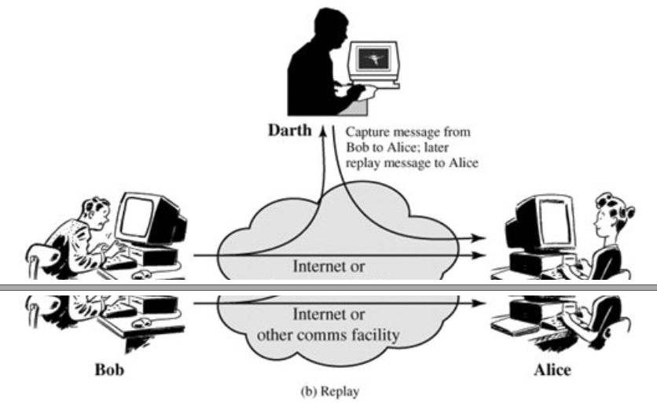
Active attack
Replay

Slide 11
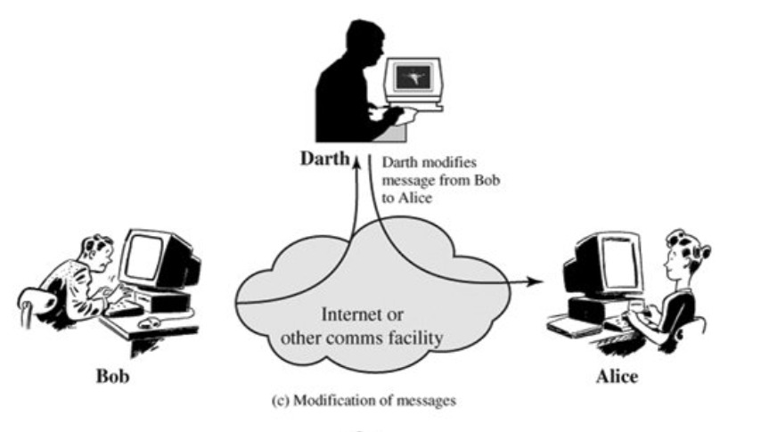
Active attack
Modification of message

Slide 12
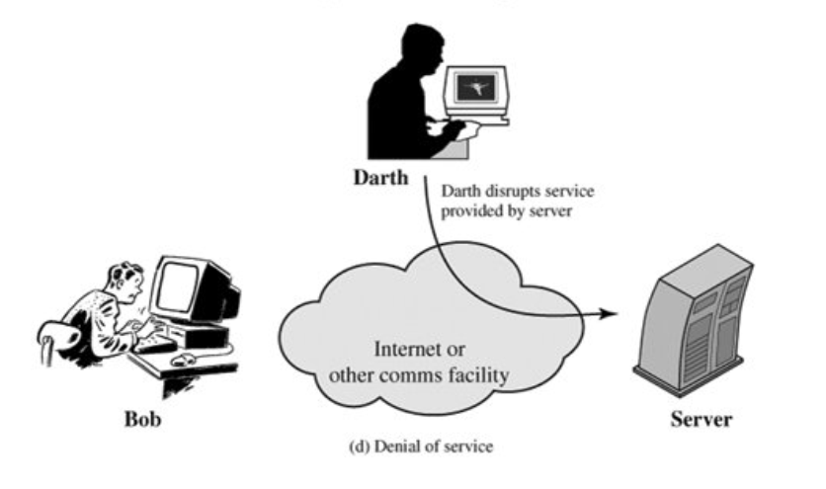
Active attack
Denial of service

Slide 13
Solution:
Security Level 1
Encryption

Slide 14
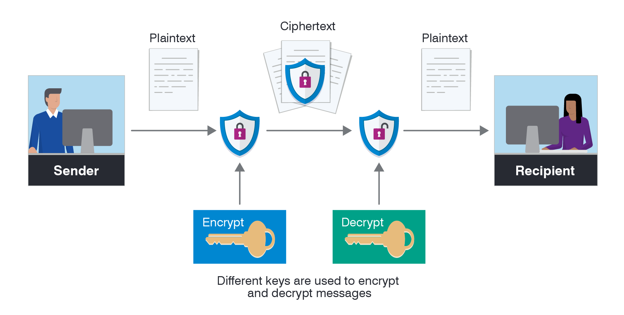
the process of transforming plaintext data into ciphertext in order to conceal its meaning and so preventing any unauthorized recipient from retrieving the original data.
Encryption
plaintext
ciphertext
plaintext

Slide 15
Encryption
Useful
Strong
Not effect
Active/Replay
Active & Passive
Active/Denial

Slide 16
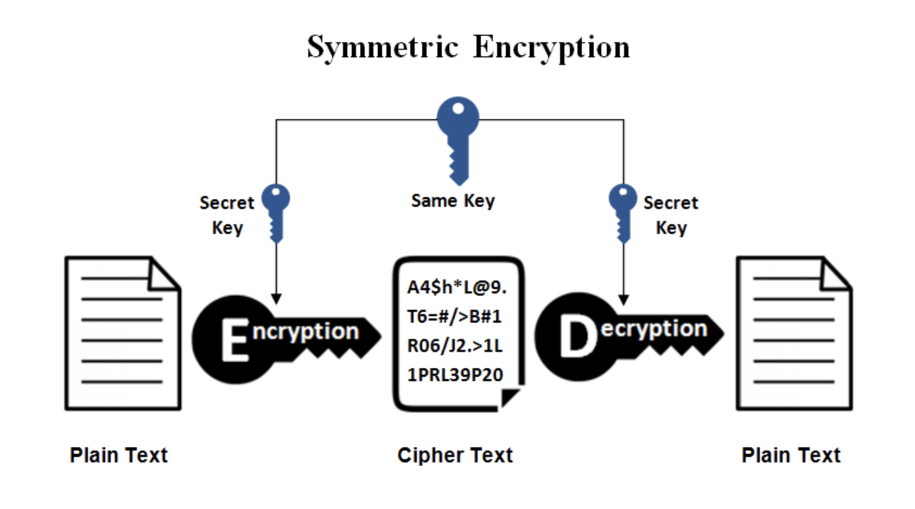
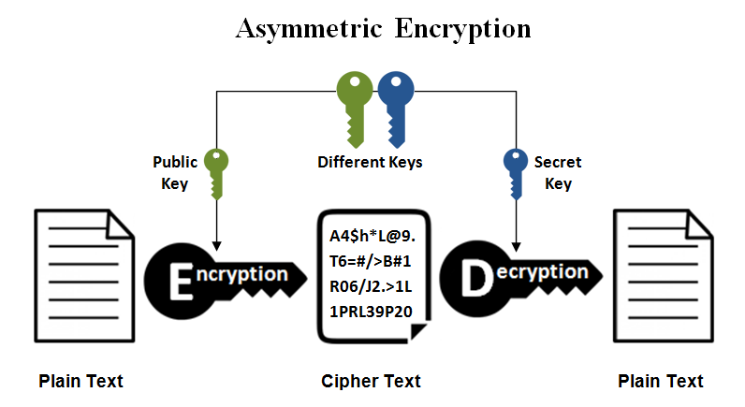

Encryption
Private Key Encryption
Public Key Encryption

Slide 17
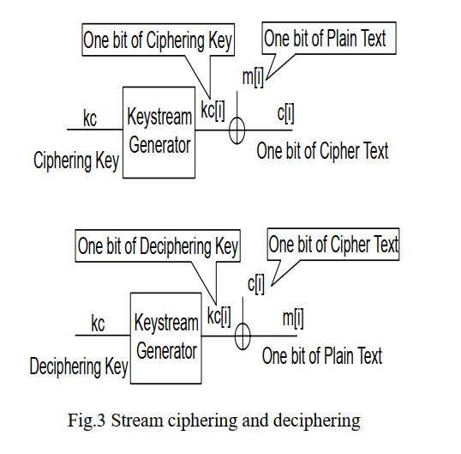
METHODS OF ENCRYPTION
Stream Cipher
one of the simplest methods of encrypting data where each bit of the data is sequentially encrypted using one bit of the key
In order to make a stream cipher more difficult to crack, one could use a crypto key which varies in length. This would help to mask any discernible patterns in the resulting ciphertext.
Advantage: Faster
EX: RC4

Slide 18
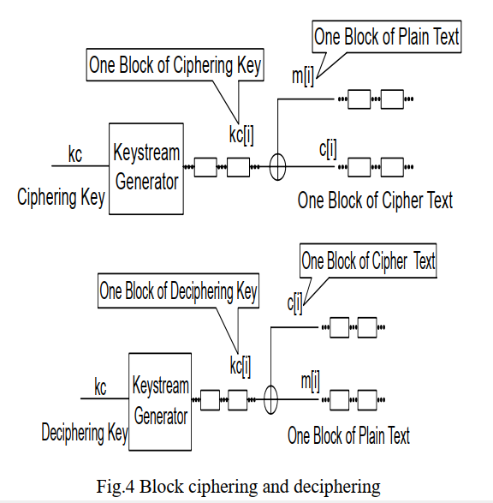
METHODS OF ENCRYPTION
Block Cipher
Encrypt data in chunks of a specific size with specific size key.
If two blocks of data contain exactly the same information, the two resulting blocks of ciphertext will be identical.

Slide 19
METHODS OF ENCRYPTION
One Way Encryption
Hybrid Systems
The plaintext can never be recovered from the cipher text
combining public and private key cryptosystems, it is possible to overcome some of the disadvantages of each

Slide 20
RC4 Algorithm
Stream cipher
Symmetric key
Very quick in software
Used for secured communications as in the encryption of traffic to and from secure web sites using the SSL protocol.
uses a variable length key from 1 to 256 bit to initialize a 256-bit state table

Slide 22
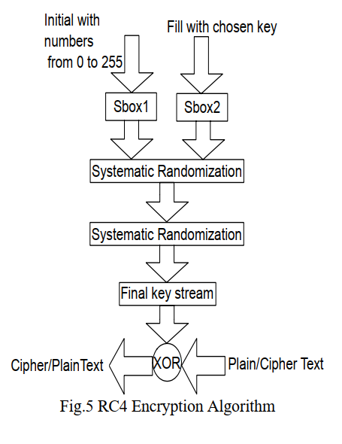
RC4 Steps
Get the data to be encrypted and the selected key
1
Create two string arrays
2
Initiate one array with numbers from 0 to 255
3
Fill the other array with the selected key
4
Randomize the first array depending on the array of the key
5
Randomize the first array within itself to generate the final key stream
6
XOR the final key stream with the data to be encrypted to give cipher text
7

Slide 23
Secure Socket Layer(SSL)

Slide 24
What is SSL
It is an internet protocol for secure exchange of information between client and a server
Developed by Netscape in 1994
SSL encrypt the segments of network connections at the Transport Layer end-to-end

Slide 25
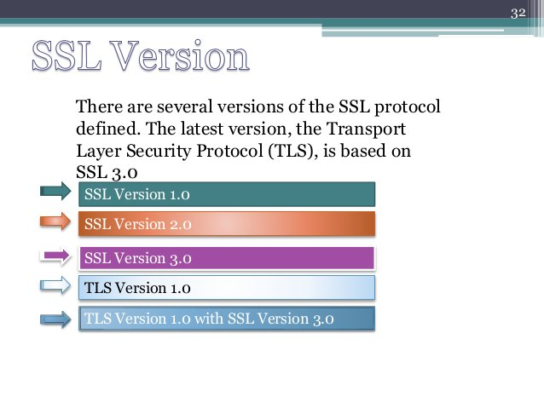

Slide 26
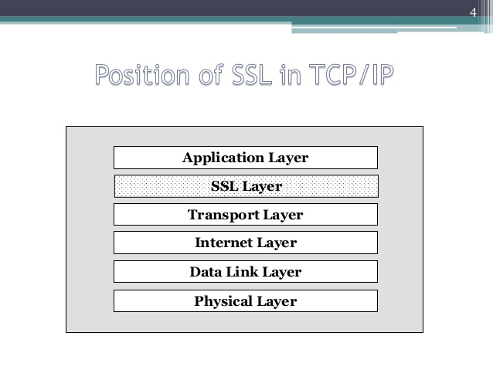
The SSL layer is located between the application layer and the transport layer

Slide 27
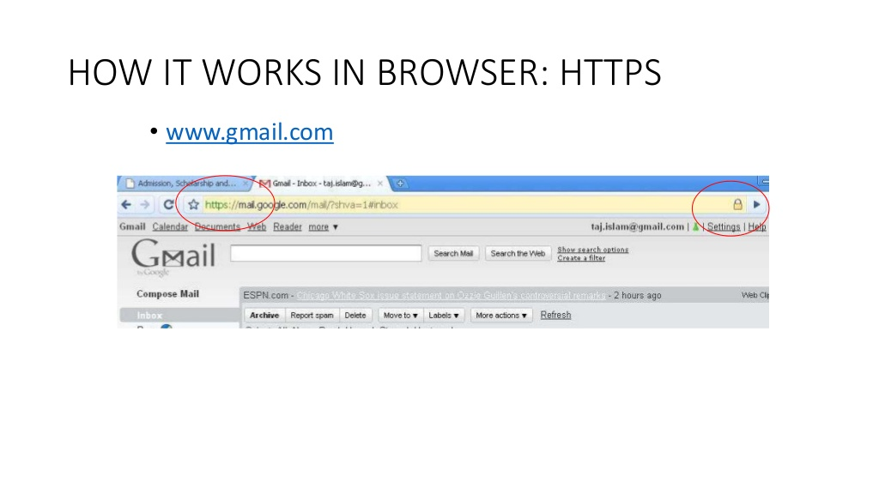

Slide 28
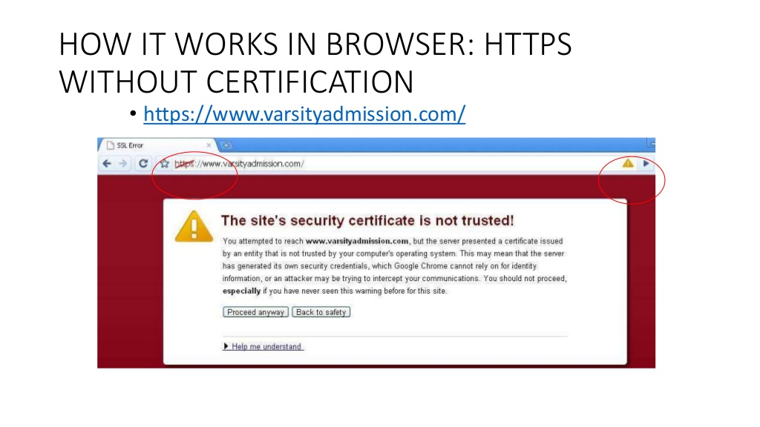

Slide 29
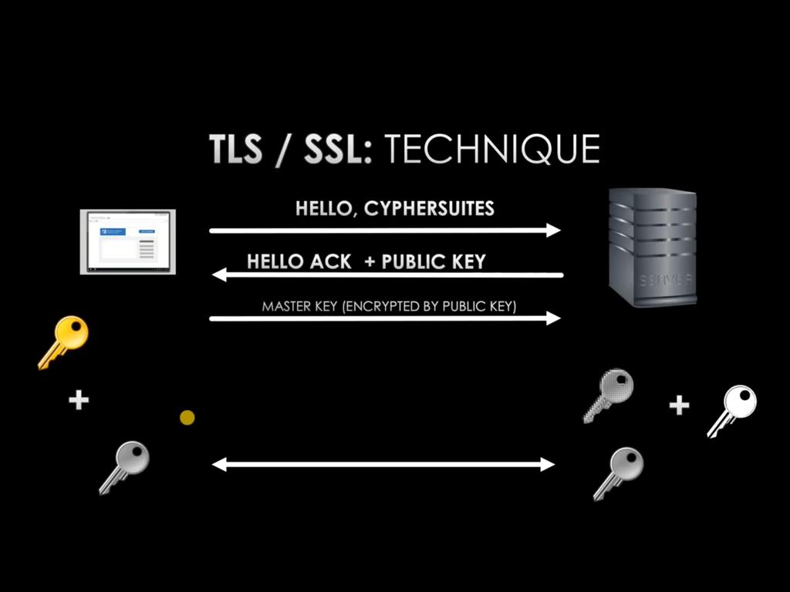
SSL technique

Slide 30




Hello ,CYPHERSUITES
Hello ACk +public key
MASTER KEY (ENCRYPTED BY PUBLIC KEY)

Slide 32
Parking
Private
Public

Slide 33
SSP Public parking
Problem
No places for parking
Solution
User can book your place in any time using our web site.

Slide 34


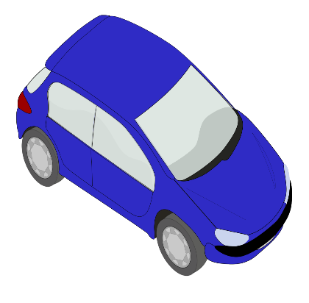

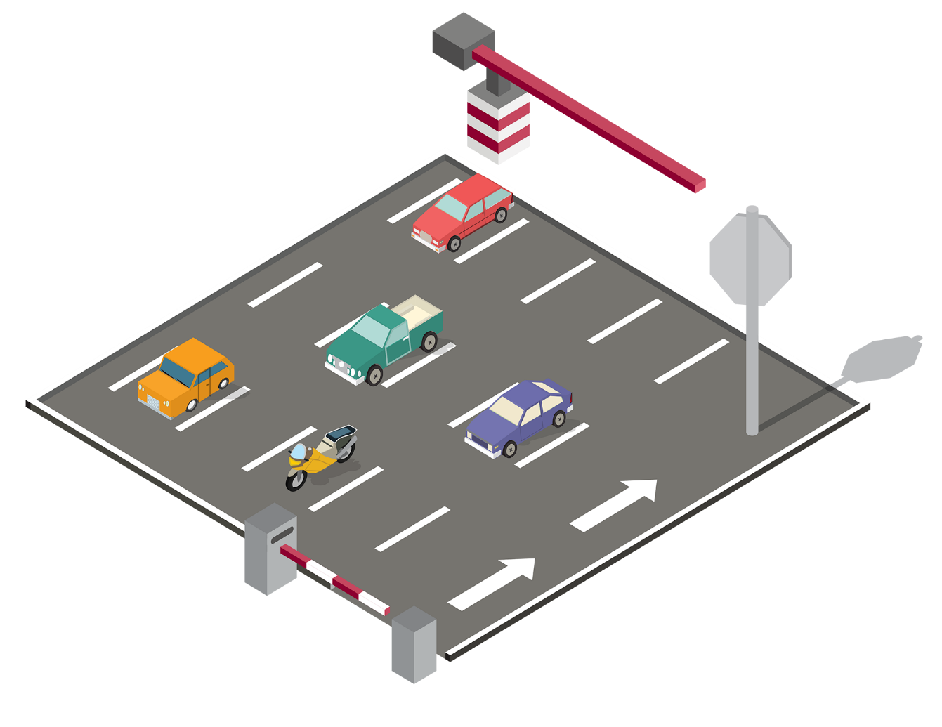
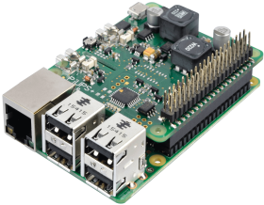

SSP Public parking
Store information of book
(car plate)
Exchange
Information
Yes this car plate book in this time
(open gate)
Send request
to open gate
Exchange
Information

Slide 35
SSP private parking
Problem
Allow access for specific persons
Solution
Use local AI system to allow to pass acceptable persons only.

Slide 36

SSP private parking
Yes this person or car exist in local database
(open gate)

Slide 37
Both Systems uses two options
Car Plate Recognition
Face Recognition

Slide 38

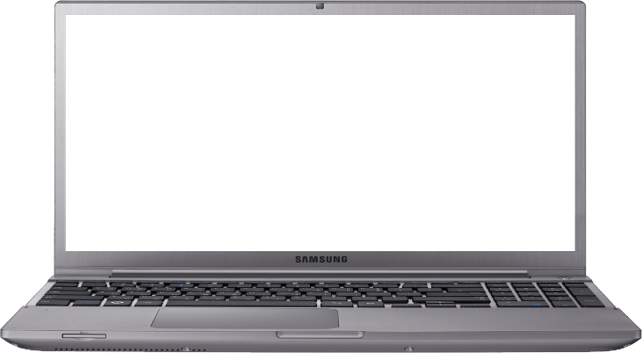

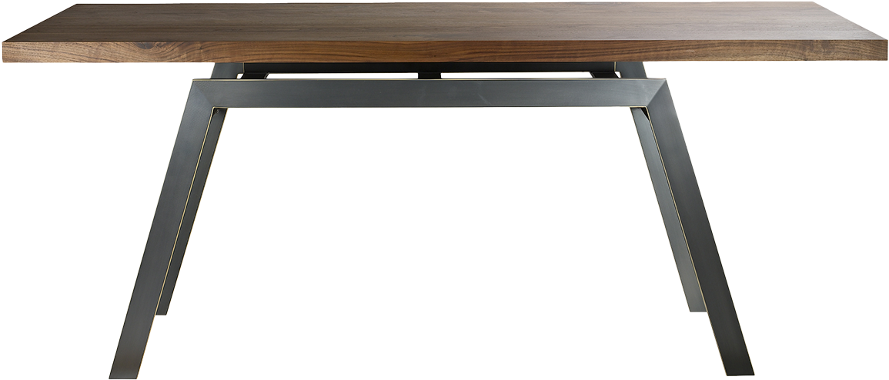
Website
Application

Slide 39



Website application
Programming
Design

Slide 40
Website application
Design

Slide 41
Website application
Programming

Slide 42
Website application: Programming
Server side
Data are processing on our server
Client side
Data are processing on PC of client

Slide 43





SSP>> website>> programming>> tools
Software
Structure of the page
Deal with client site
Deal with server site
Deal with databases
Software that runs on a server to establish a connection between a server and the browsers of website visitors
(Firefox, Google Chrome, Safari, etc.)
Override on apache configuration.

Slide 44
SSP>> website>> programming>> tools
Hardware
Namecheap Shared Hosting
ON CLOUD
Stellar Business
Datacenter Location UK

Slide 45
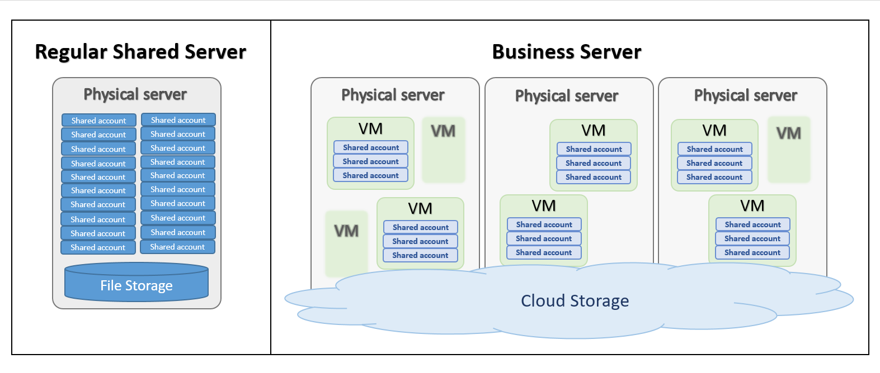
SSP>> website>> programming>> tools
Hardware
Cloud
Shared
HOSTING

Slide 46
SSP>> website>> Security
Replay effect of Active attack
Prevent by adding validation time for a message. As the message is encrypted
Even if attacker obtained the message he can't modify its validation time
Denial effect of Active attack
Prevented by making Users sending one request in a specific interval of time
Ex: User can send one email for password for every 10 minutes

Slide 47
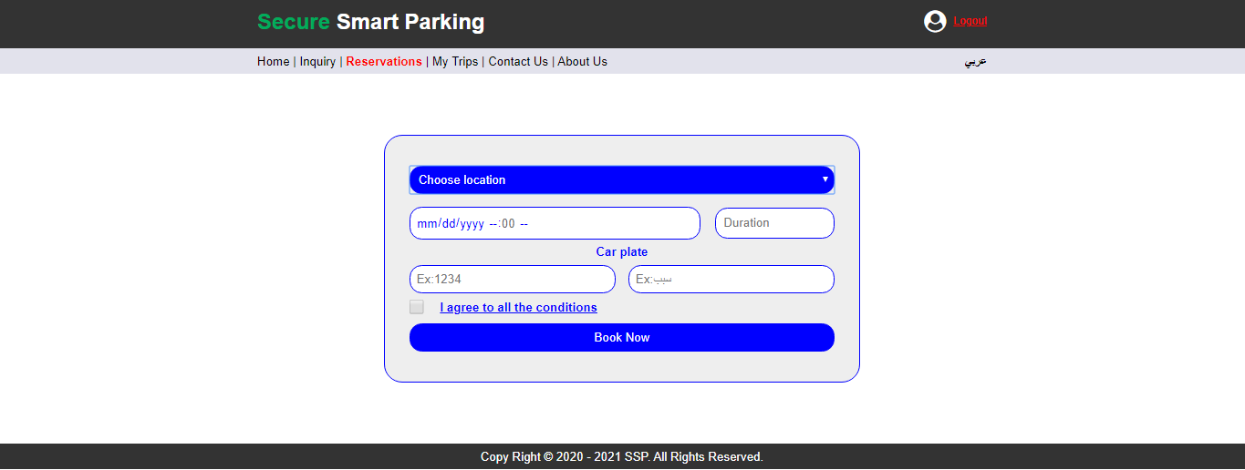

Slide 48
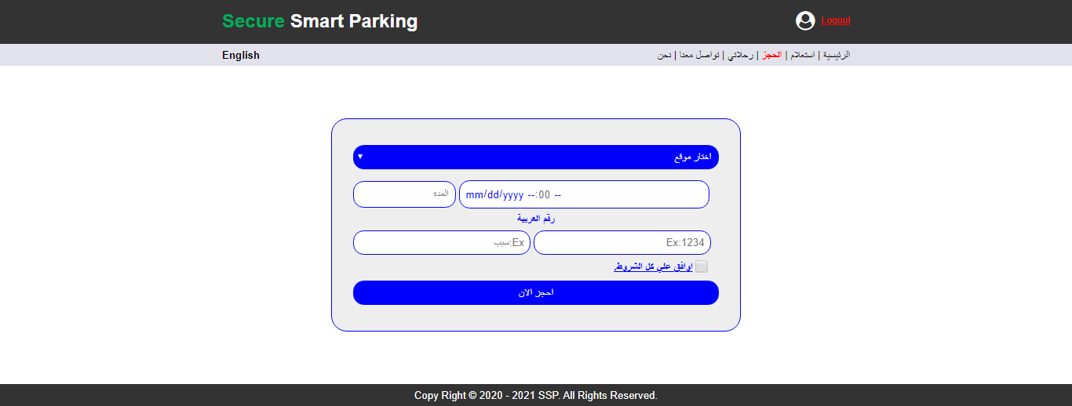

Slide 49
Website
Website support both languages Arabic and English
The client must book before the time of booking at least 30mins
the client must upload 3photo to your face and make face Recognition to ensure he is the same person

Slide 50
website
Condition 1: Price for hour is equal to 4 LE
Minimum booking hours = 1 hour

Slide 51
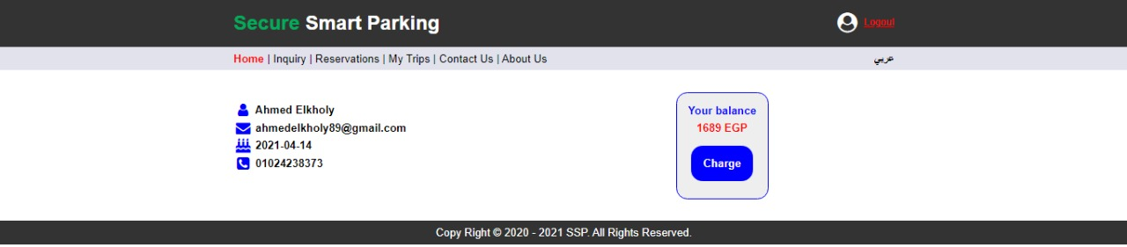
Price before 2 hours booking

Slide 52
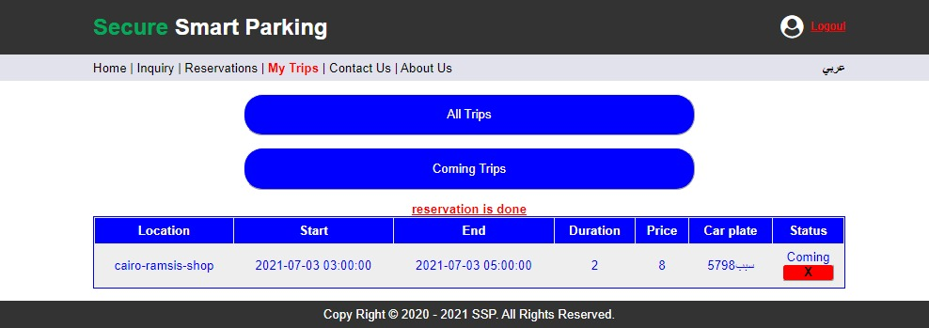
Booking 2 hours

Slide 53
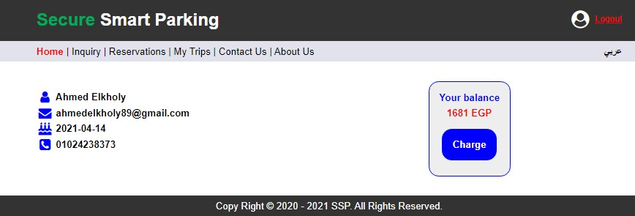
Price after booking 2 hours

Slide 54
website
Condition 2: User can cancel his booking with conditions:
Before two hours from your reservation time.

Slide 55
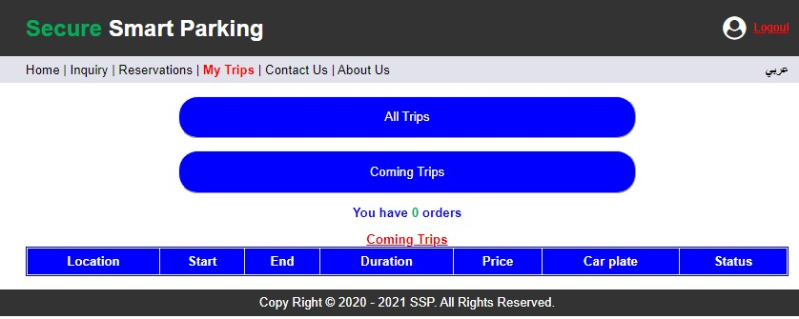
After cancelation

Slide 56
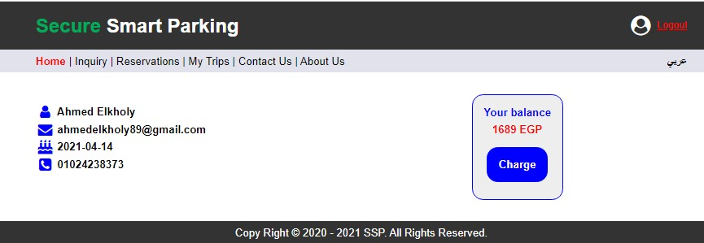
Price after cancelation

Slide 57
website
Condition 3:Web face recognition Conditions:
Used for one time for forced open gate during booking duration.

Slide 58
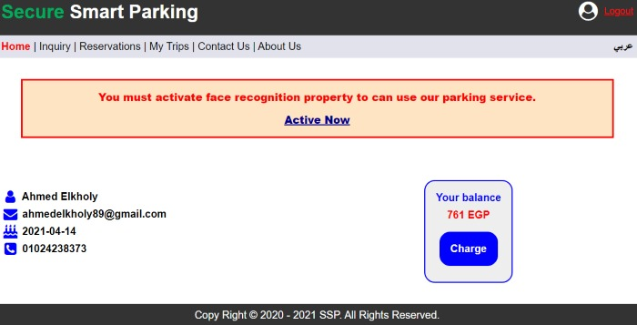
Before activation face recognition

Slide 59
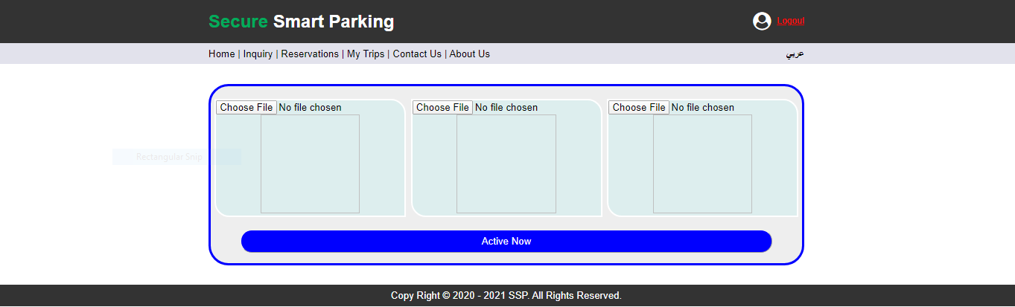
Face Activation

Slide 60
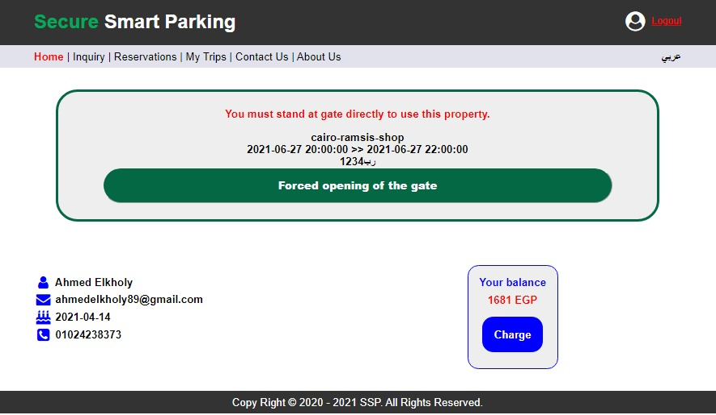
Opening Of The Gate

Slide 61
Opening Of The Gate

Slide 62
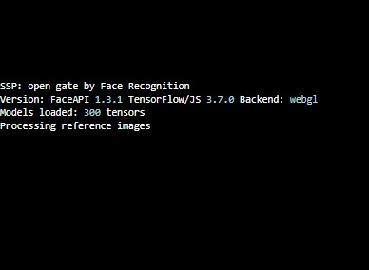

Slide 63
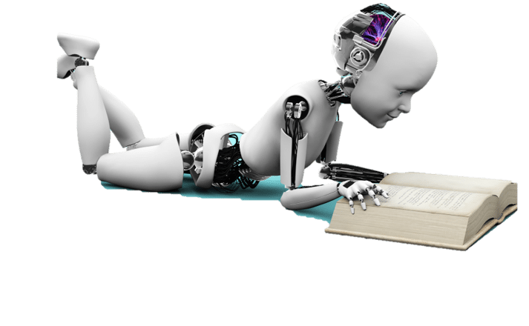
Artificial Intelligence

Slide 64
AI Techniques
Car Plate Recognition
1-AI parking system will read plates of cars
2-compare this plates with databases
3-if this plate in database, gate will open
Face Recognition
1-AI parking system will read faces of people
2-compare this faces with databases
3-if this faces exist in database, gate will open

Slide 65
OCR- Plate recognition
library
Using python

Slide 66
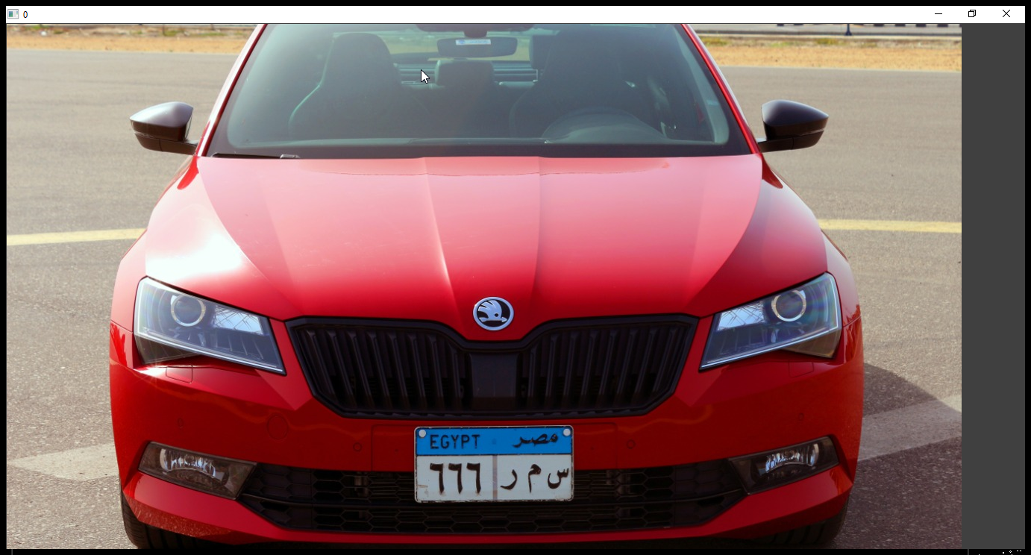
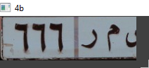
Image segmentation
1

Slide 67
Original image

Slide 68
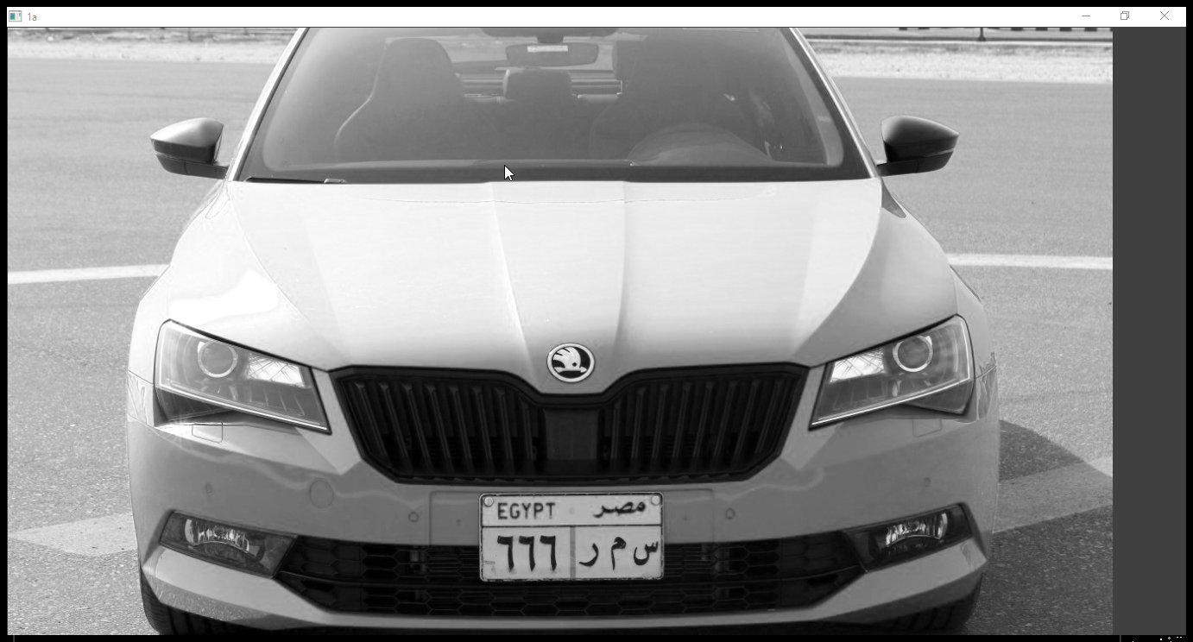
Gray image

Slide 69
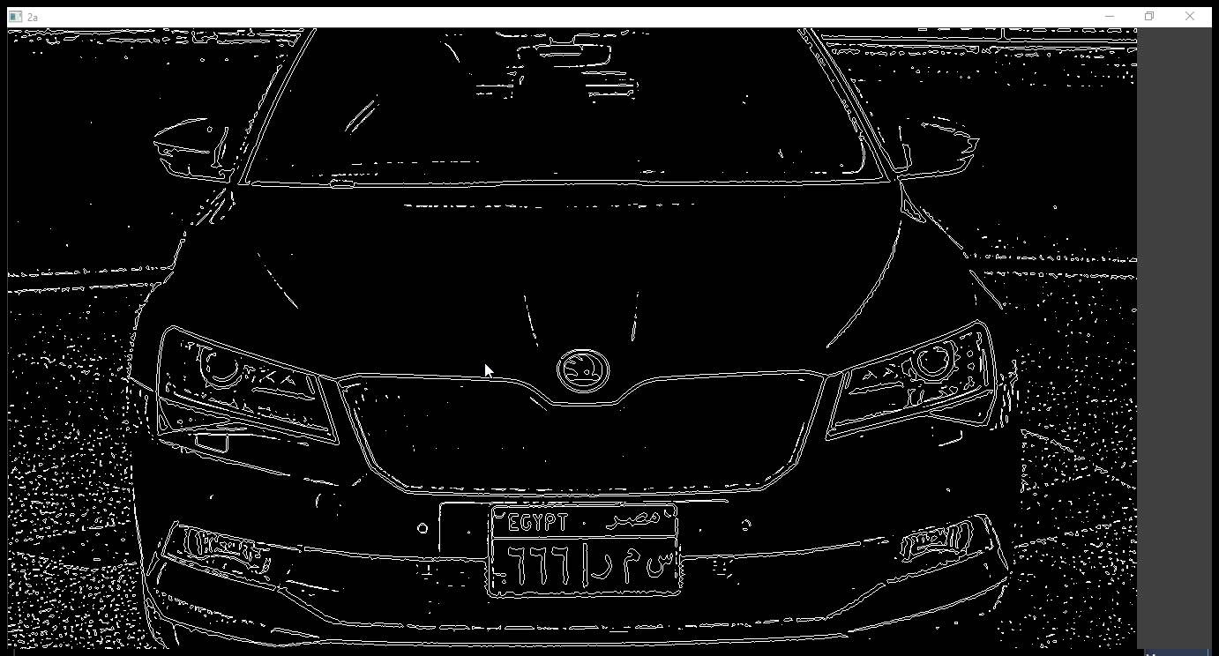
Find edge

Slide 70
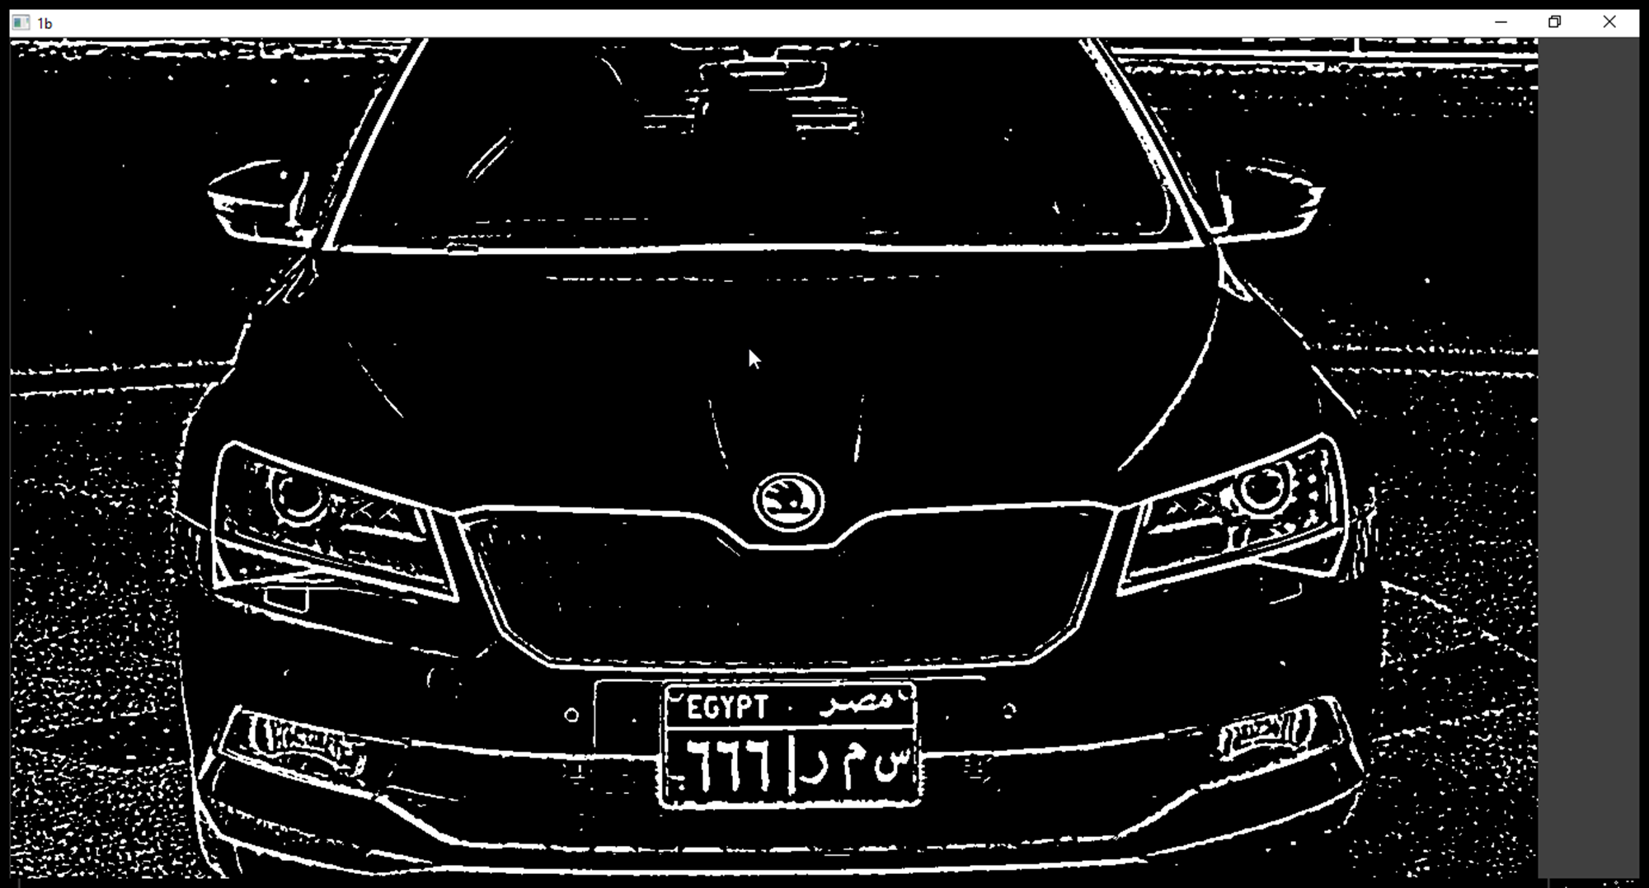
Dilate

Slide 71
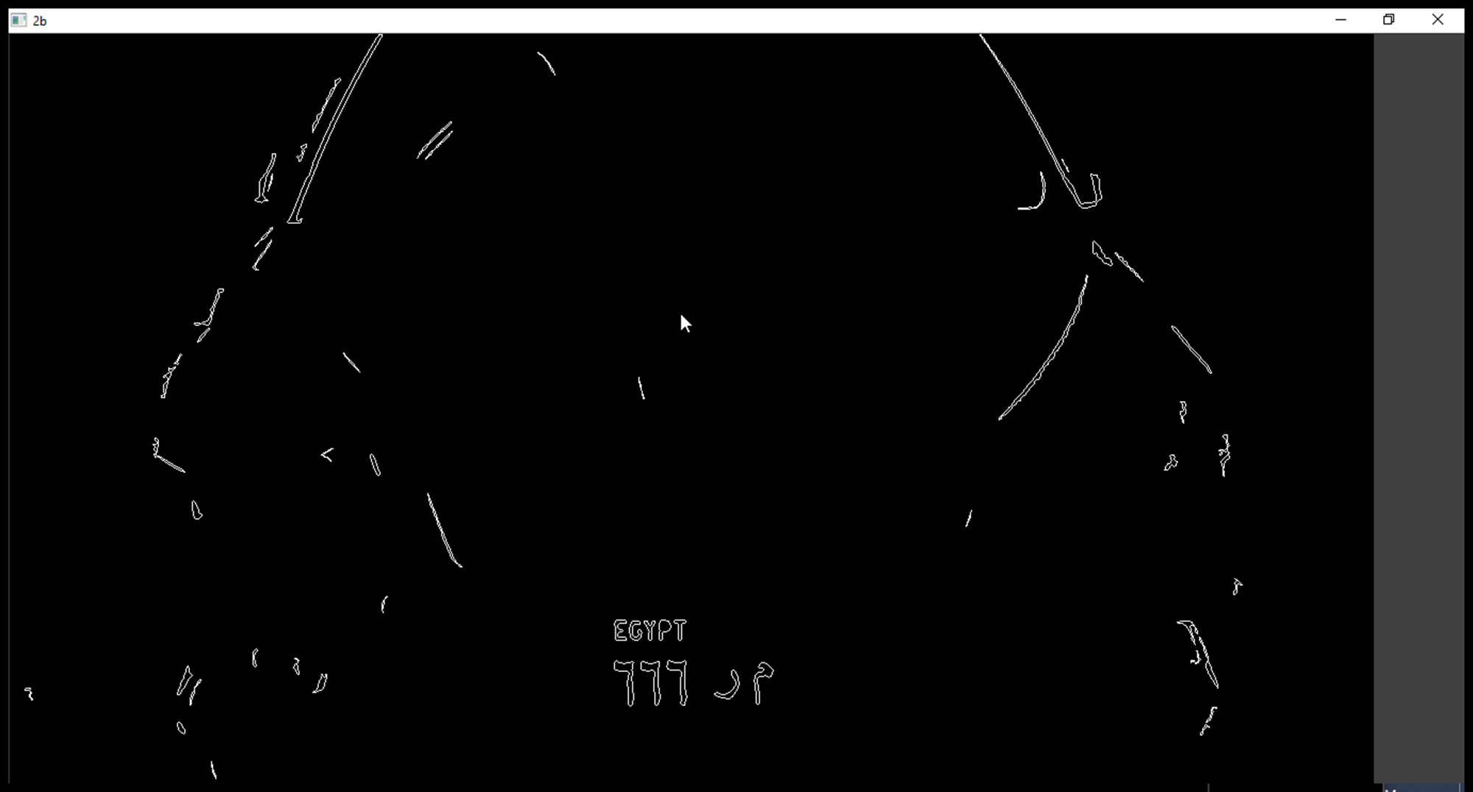
Eroded

Slide 72
Easyocr Lib
2
م ر 666

Slide 73
Face recognition library
Using python

Slide 74

Face Recognition
Make folder for each user contain on his photos

Slide 75
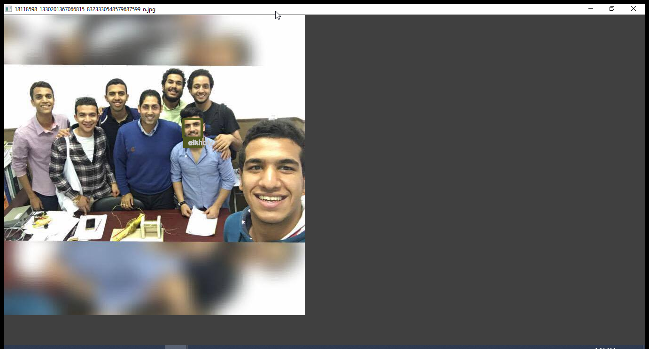
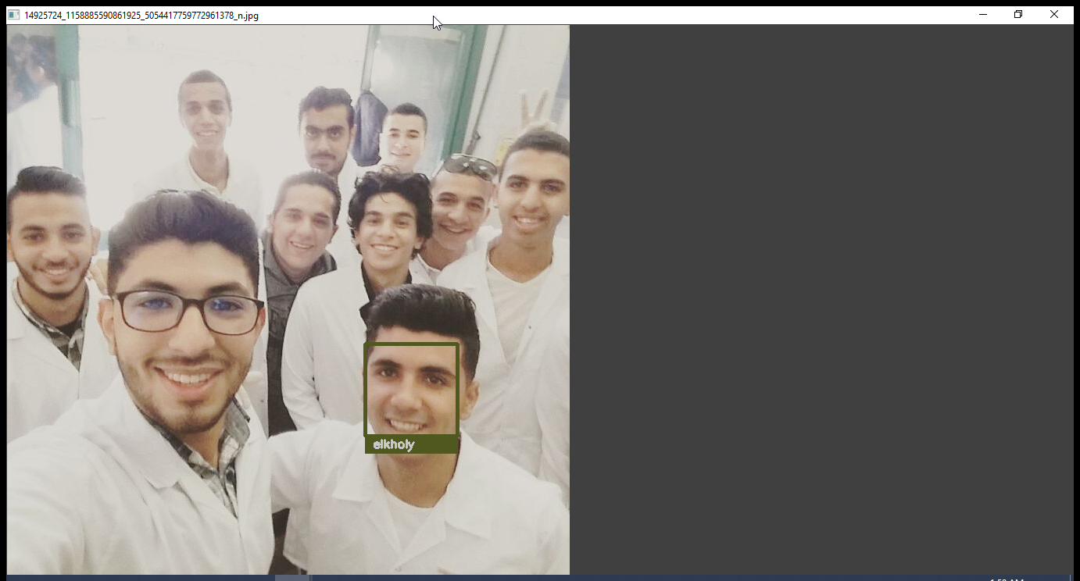
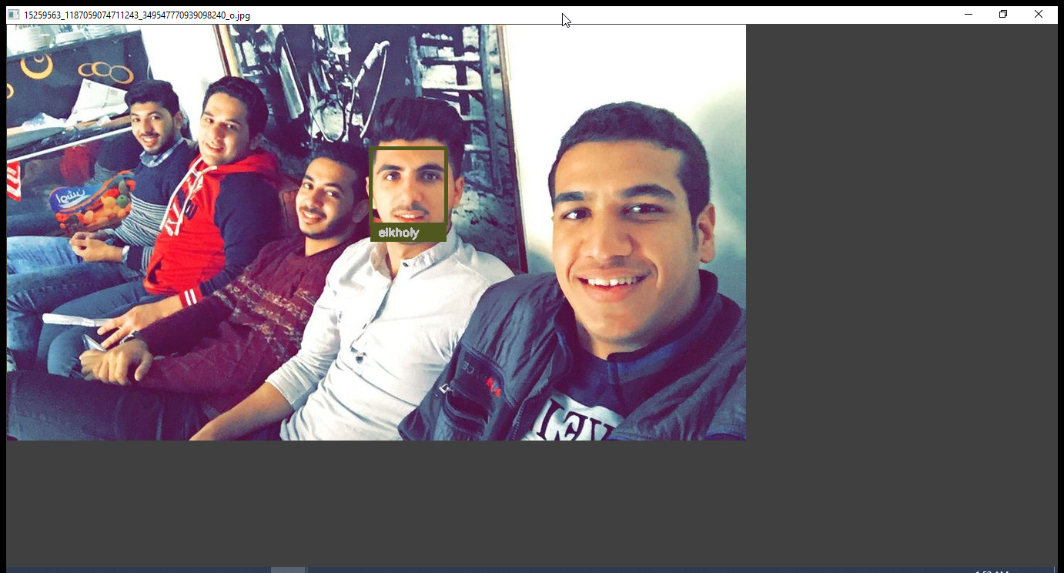
Result

